Slide 1
Pillow Library
A Sree Ram(22PT01)

Slide 2
Installation

Slide 3
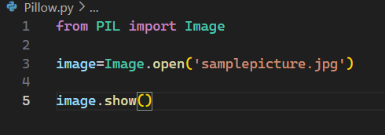

Import and display image

Slide 4
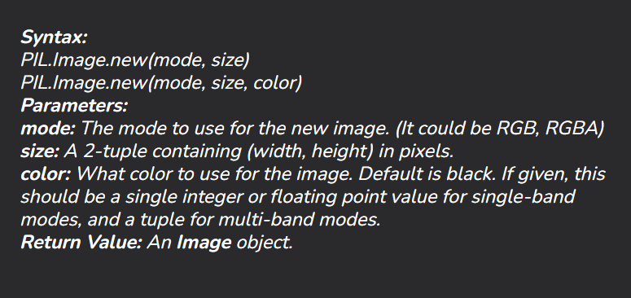
Creating an image from scratch

Slide 5
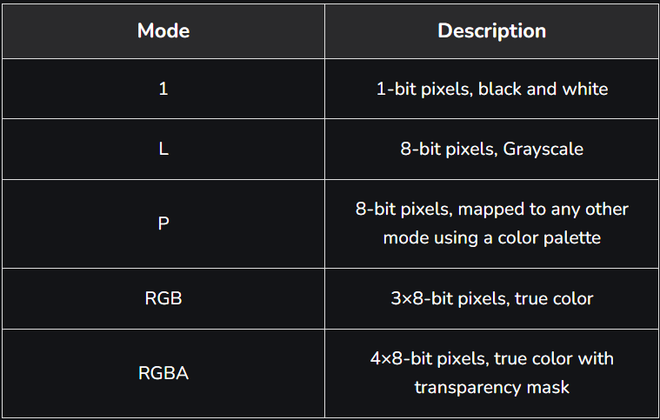

Slide 6

Saving the picture
We can save it in any format.
So we can use it to convert the type of image.

Slide 7
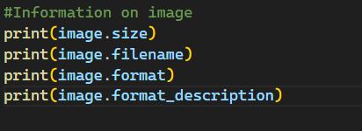

To get information on the image

Slide 8
Rotate and Crop

Slide 9
Transpose
image.transpose(Image.Transpose.Option)
Options
FLIP_LEFT_RIGHT
FLIP_TOP_BOTTOM
ROTATE_90
ROTATE_180
ROTATE_270
TRANSPOSE
TRANSVERSE

Slide 10
Image Enhancements
Color
Contrast
Brightness
Sharpness

Slide 11
Image Filters
BLUR
CONTOUR
DETAIL
EDGE_ENHANCE
EDGE_ENHANCE_MORE
EMBOSS
FIND_EDGES
SHARPEN
SMOOTH
SMOOTH_MORE

Slide 12
BLUR – Softens the image by averaging pixel values in a small area, reducing sharpness and detail.
CONTOUR – Detects edges in the image and highlights them, creating an outline-like effect.
DETAIL – Enhances fine details in the image while preserving overall structure.
EDGE_ENHANCE – Enhances edges in the image, making transitions between colors and shapes more distinct.
EDGE_ENHANCE_MORE – A stronger version of EDGE_ENHANCE, increasing edge contrast more significantly.

Slide 13
EMBOSS – Highlights edges and gives the image a 3D effect by creating a raised or pressed look.
FIND_EDGES – Detects edges in the image and highlights them, often producing a high-contrast result with white edges on a black background.
SHARPEN – Increases the sharpness of the image by enhancing contrast at edges.
SMOOTH – Softens the image by reducing noise and smoothing out color transitions.
SMOOTH_MORE – A stronger version of SMOOTH, applying more aggressive smoothing.

Slide 14
Image.new("RGBA", (200, 200), (255, 0, 0, 128)).show()
img1=Image.new('RGBA', (200, 200), (255, 0, 0,255))
img2=Image.new('RGBA',(200,200),(0,255,0,128))
Image.alpha_composite(img1,img2).show()

